Slide 1
EVCI

Slide 2
Software Components of EVCI
1. Charging Station Management System (CSMS)
2. Energy Management Systems (EMS)
3. User-Facing Applications
4. Communication Protocols
5. Integration with Building and Grid Systems
6. Data Analytics and Reporting Tools
7. Cybersecurity and Compliance Modules

Slide 3
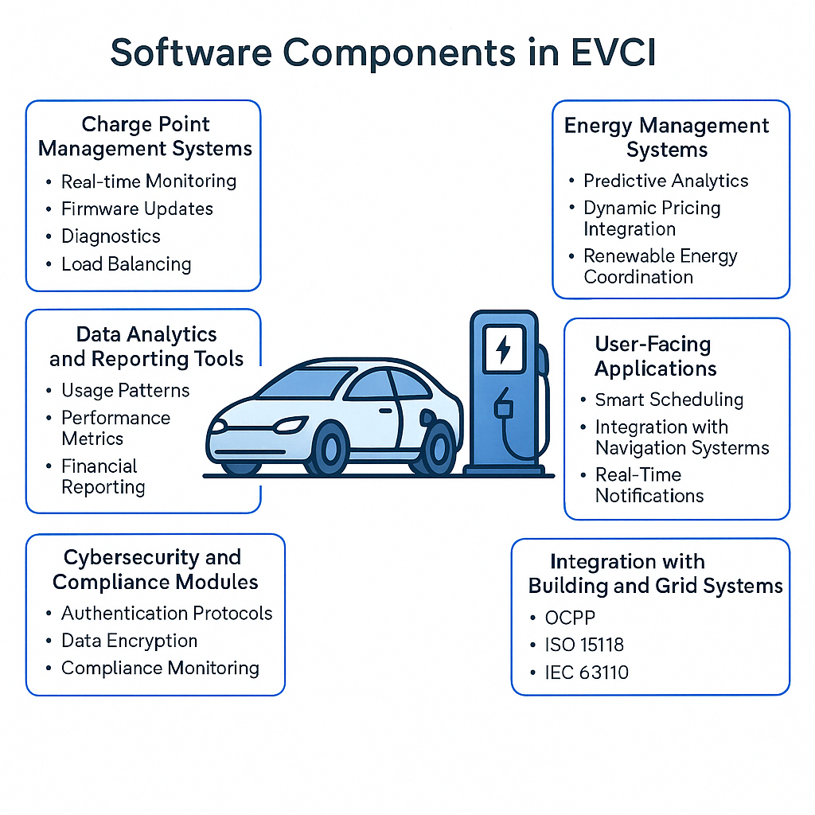

Slide 4
Charging Station Management System (CSMS)
Core Functions of CPMS
Real-Time Monitoring and Control
Provides live status updates of charging stations (e.g., available, in use, offline).
Allows remote control capabilities, such as starting or stopping charging sessions.​
User and Session Management
Handles user authentication and authorization processes.
Manages charging sessions, including initiation, termination, and tracking.​
Billing and Payment Integration
Calculates charging costs based on energy consumption and pricing models.
Integrates with payment gateways to facilitate transactions.​
Load and Energy Management
Implements dynamic load balancing to optimize energy distribution.
Supports integration with renewable energy sources and grid services.​
Maintenance and Diagnostics
Monitors equipment health and performance metrics.
Provides alerts and diagnostics for proactive maintenance.

Slide 5
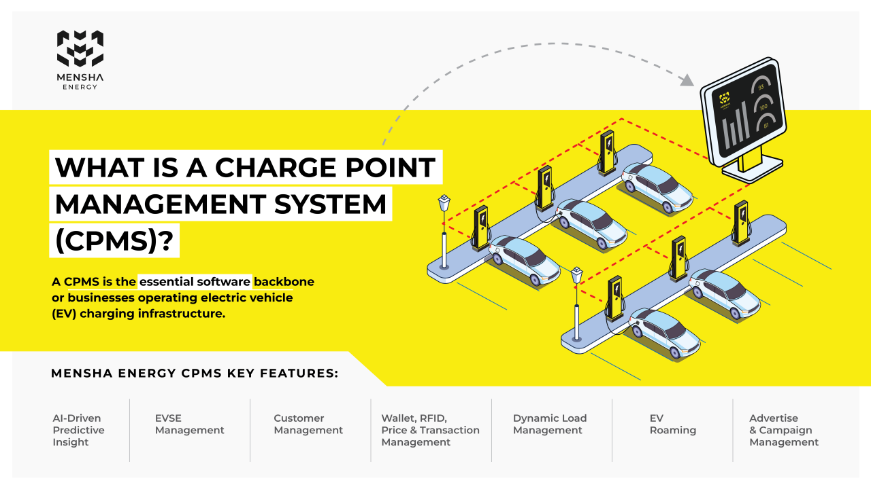

Slide 6
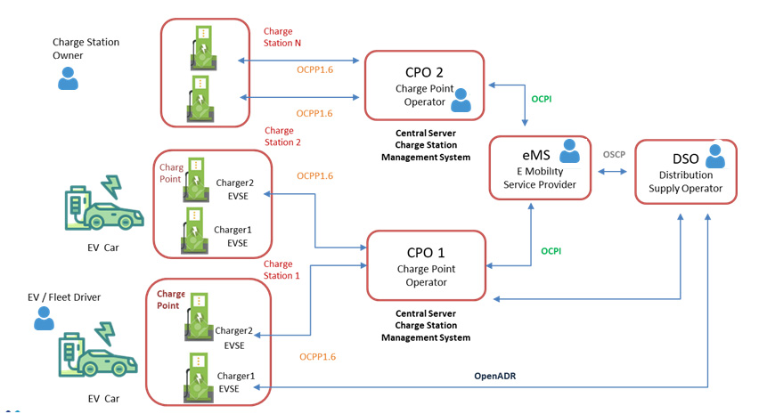

Slide 7
Importance of Open Protocols
CSMS platforms often utilize open communication protocols like the Open Charge Point Protocol (OCPP) to ensure interoperability between different hardware and software vendors. This flexibility allows operators to integrate various charging stations and management systems without being locked into a single provider.

Slide 8
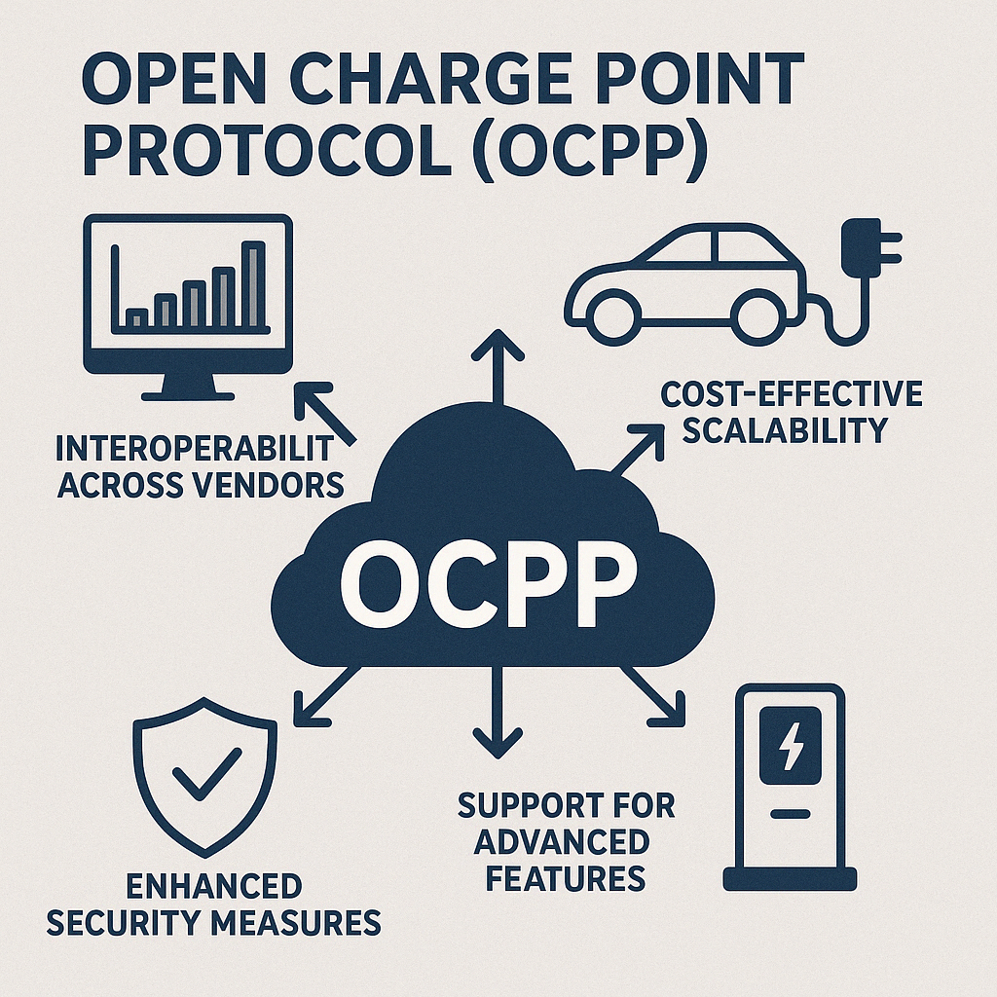
Key Benefits of OCPP in EV Charging Infrastructure
1. Interoperability Across Vendors
2. Cost-Effective Scalability
3. Enhanced Security Measures
4. Support for Advanced Features

Slide 9
User Access Management Core Components

Slide 10
1. Authentication Mechanisms
CSMS supports various ways for users to identify themselves before charging:
RFID cards (tap-and-charge)
Mobile apps (login + QR scan/NFC)
Plug & Charge (vehicle-based ID using ISO 15118)
Web portals (username/password)
Token or OTP-based systems

Slide 11
2. User Roles & Permissions
Drivers: Limited access, usually just to initiate and monitor sessions.
Fleet Managers: Can view multiple vehicle accounts, usage history, and reports.
Operators/Admins: Full access to pricing, configurations, diagnostics, etc.

Slide 12
3. Account Linking & Payment Integration
Each user can have an account linked to:
A wallet or payment method
A subscription plan
Company billing, for fleets or workplaces
Billing is handled automatically after successful authentication.

